Slide 1

Stock Analysis and Prediction System using Stacked-LSTM (Stock Predictor)
SRM Institute of Science and Technology
College of Engineering & Technology | School of Computing
Department of Computing Technologies
18CSC305J Artificial Intelligence – Mini Project
Team Members
RA2111003010453 Utkarsh Raj Sinha
RA2111003010454 Amal Krishna M K
RA2111003010480 Debasish Ray

Slide 2
Abstract
Deep Learning for Complexities: This novel stock prediction system leverages Long Short-Term Memory (LSTM) networks, a powerful type of neural network that excels at capturing hidden patterns and relationships within historical stock data. This allows the system to handle the inherent complexity of stock movements.
Time Matters: Capturing Trends: By harnessing the sequential learning power of LSTMs, the system excels at modeling the dynamic nature of stock prices. It can account for both short-term fluctuations and long-term trends, leading to more accurate predictions.
Data-Driven Insights for Informed Decisions: The system utilizes machine learning to extract valuable insights from vast amounts of historical data, technical indicators, and potentially even external factors. These robust forecasts empower investors with actionable intelligence, enabling informed decision-making in the dynamic world of finance.

Slide 3
Introduction
The world of back may be a energetic environment where quick decision-making is essential for victory. In this setting, exact and convenient forecasts of stock advertise developments hold colossal esteem for financial specialists, dealers, and budgetary educate. The "Stock Expectation Framework utilizing Stacked-LSTM" extend speaks to a cutting-edge endeavor at the crossing point of manufactured insights and fund, pointing to use progressed profound learning strategies to estimate stock costs with made strides exactness.
Built upon the establishment of Stacked Long Short-Term Memory (LSTM) systems, this extend looks for to address the inalienable challenges of stock advertise expectation, counting non-linearity, worldly conditions, and loud information. By stacking numerous LSTM layers, the demonstrate picks up the capacity to capture complex designs and conditions inside authentic stock cost information, subsequently improving its prescient capabilities.
Through this venture, we set out on a travel to thrust the boundaries of conventional determining strategies, grasping the control of profound learning to open significant bits of knowledge from tremendous streams of monetary information. With a center on development and meticulousness, we yearn to create a strong and solid framework that engages partners with timely and precise forecasts, empowering educated decision-making within the complex and energetic world of stock exchanging and speculation.

Slide 4
Use Cases
The "Stock Prediction System using Stacked-LSTM" project has several potential uses and applications in the realm of finance and investment.
Exchanging Methodology Improvement:
The exact expectations created by the framework can serve as the premise for creating algorithmic exchanging procedures. Dealers can utilize these forecasts to computerize buy/sell choices, optimize portfolio allotments, and capitalize on short-term showcase patterns.
Risk Management:
Speculators and finance directors can use the expectations to evaluate and oversee dangers related with their venture portfolios. By joining forecasted stock costs into hazard models, they can make more educated choices to moderate potential misfortunes.
Portfolio Optimization:
The system's expectations can help within the optimization of speculation portfolios by recognizing resources with tall anticipated returns or moo instability. Portfolio supervisors can utilize these bits of knowledge to rebalance their portfolios and maximize returns whereas minimizing chance.

Slide 5
Challenges / Motivation
Data Quality and Quantity: While linking dataset with main python application file , we are facing issues like different features included in dataset. Ex. index, date, open ,close columns etc. Some of them are not required for model training.
Complexity of Financial Markets: Financial markets are influenced by a multitude of factors including economic indicators, geopolitical events, company performance, investor sentiment, and more. Capturing and incorporating all relevant information accurately into predictive models is challenging.
Non-linearity and Volatility: Stock prices often exhibit non-linear and volatile behavior, making prediction difficult. Traditional linear models may not adequately capture the complex relationships between variables. Our model (Stacked-LSTM) is created with updation of real-time values of different stocks.So, if website stores NaN values , then model accuracy for prediction decreases.

Slide 6
Challenges / Motivation
Market Dynamics and Adaptability: Markets are dynamic and constantly evolving. A model that performs well in one market condition may not perform well in another. The ability of the AI system to adapt to changing market dynamics is essential for its long-term success.
Overfitting and Generalization: There is a risk of overfitting models to historical data, which may lead to poor performance on unseen data. Ensuring that models generalize well to new data is a key challenge.
Interpretability: Many AI models used in stock analysis are complex and difficult to interpret. Understanding the rationale behind a model's predictions is important for gaining trust from users and stakeholders.

Slide 7
Challenges / Motivation
Regulatory and Ethical Considerations: There are regulatory constraints and ethical considerations surrounding the use of AI in financial markets. Compliance with regulations and ensuring ethical use of AI is a critical concern.
Competitive Landscape: The field of AI-driven stock analysis is competitive, with many players vying to develop the most accurate and profitable models. Staying ahead of competitors and continuously improving model performance is a key motivation.

Slide 8
Problem Statement
Statement : Software Tool to aid the investment analyst in investing based upon the predictions made by model .
Description: If a investment analyst or Portfolio Manager wants to view specific stock prediction for future using our Model, Investment analysts are tasked with making informed decisions regarding investment opportunities in financial markets. However, the vast amount of data and complex market dynamics often make it challenging to accurately assess the potential of various investment options. To address this challenge, a software tool is needed to aid investment analysts in making investment decisions based on predictions made by machine learning models.

Slide 9
Literature Survey
Authors | Title | Dataset | Methods | Remarks
Vikas Deswal and Dharminder Kumar | Stock Price Prediction of AAPL Stock by Using Machine Learning Techniques: A Comparative Study | AAPL Stock Dataset | This section describes the machine learning models used to train and test collected data. There are various types of regression models for machine learning. The main focus is on Linear Regression, SVM, Random forest, Neural Network and LSTM algorithm. | This paper concludes that LSTM (based on basic parameters) is a good algorithm for stock price prediction.
Dr. Garima Bhardwa | Application of Neural Network to Technical Analysis of Stock Market Prediction | S&P 500 index 365 trading days | This paper strives to evolve and innovate a stricter neural network reach to anticipate the stock market. This paper depicts a technical analysis of stock market prognosis through neural networks. | This research is just a beginning and the long time goal is to predict the trend of the rate variant along with numerous influential factors inclusive of technical analysis and fundamental analysis.

Slide 10
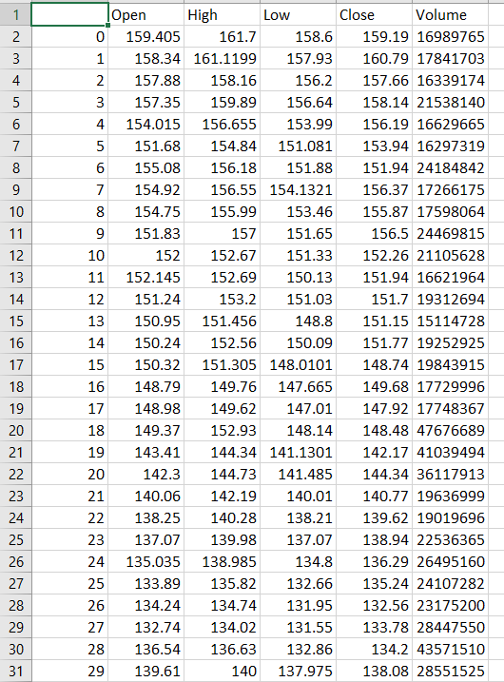
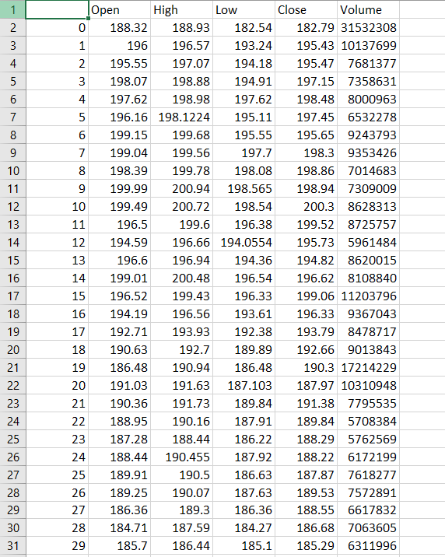
Dataset
Google Real-Time Dataset (By YFinance)
JP-Morgan Real-Time Dataset (By YFinance)

Slide 11
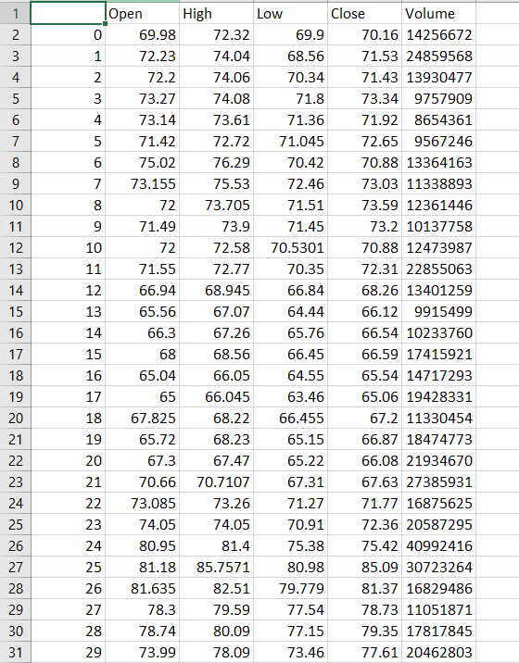
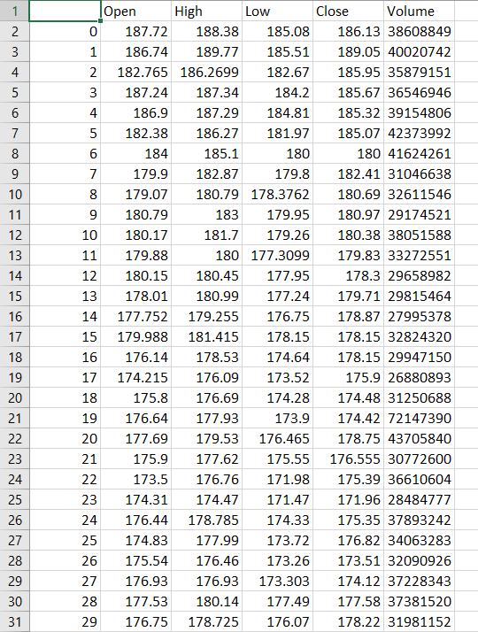
Dataset
Marvel Real-Time Dataset (By YFinance)
Amazon Real-Time Dataset (By YFinance)

Slide 12
Methodology
The methodology include steps:
Preprocessing of data- Removal of NaN values from dataset. Also, resizing of dataset and removing unwanted columns which are not required for model-training.
Sequence Generation- Further steps includes checking and checking the data-type of each feature or columns to avoid any error generation during model initialization.
Model-Architecture- Model Architecture is considered to be an important part of model-training like defining the type of model and model selection, definition the no. of Layers in LSTM , input type , dropout value, optimizers and return sequence parameters in LSTM.
Model-Training- Selecting 70% data for training and 30% data for testing from the dataset, which can be later used for model evaluation.
Metri-Calculation- Based on model-metrics generated, the efficiency and power of model is assumed and selected for project in order to predict the values of stock data and execution of model results in our website.
Integration with website- After creating the model, use of streamlit and react-js dashboard for user to evaluate and calculate the predictability of stock , so that the user can easily invest in it.

Slide 13
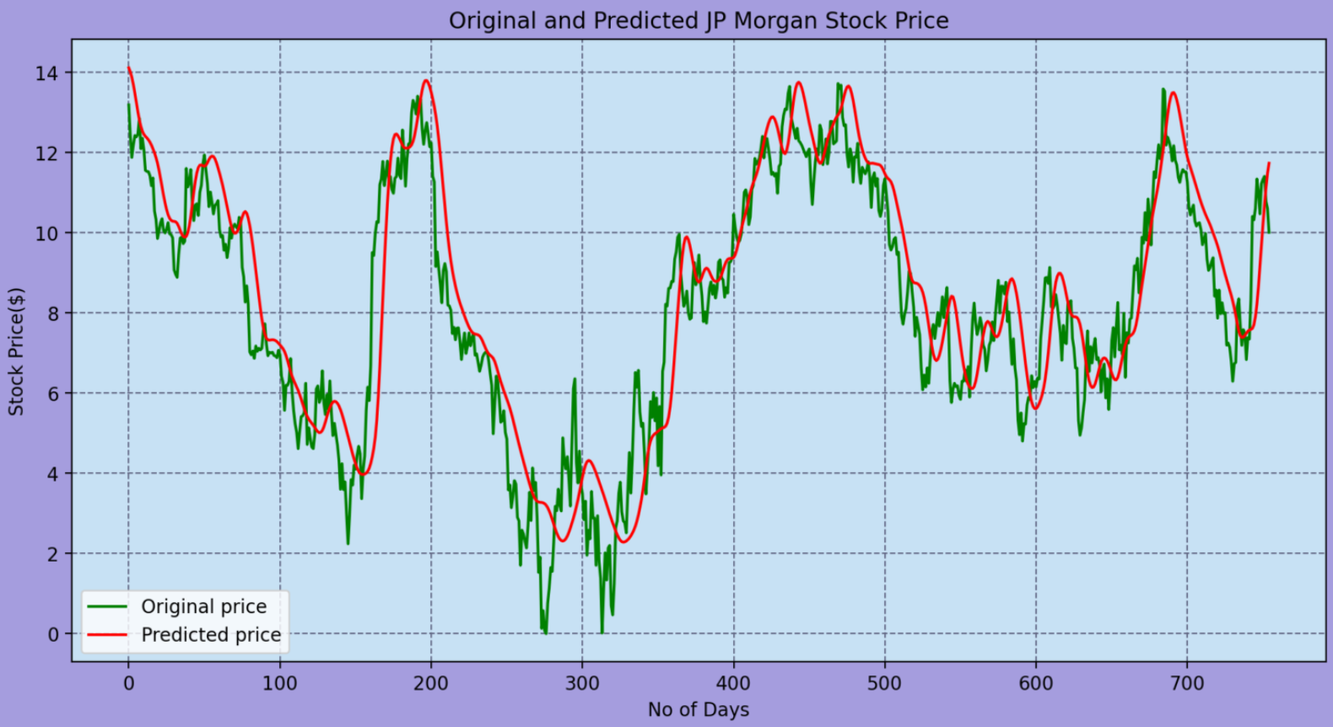
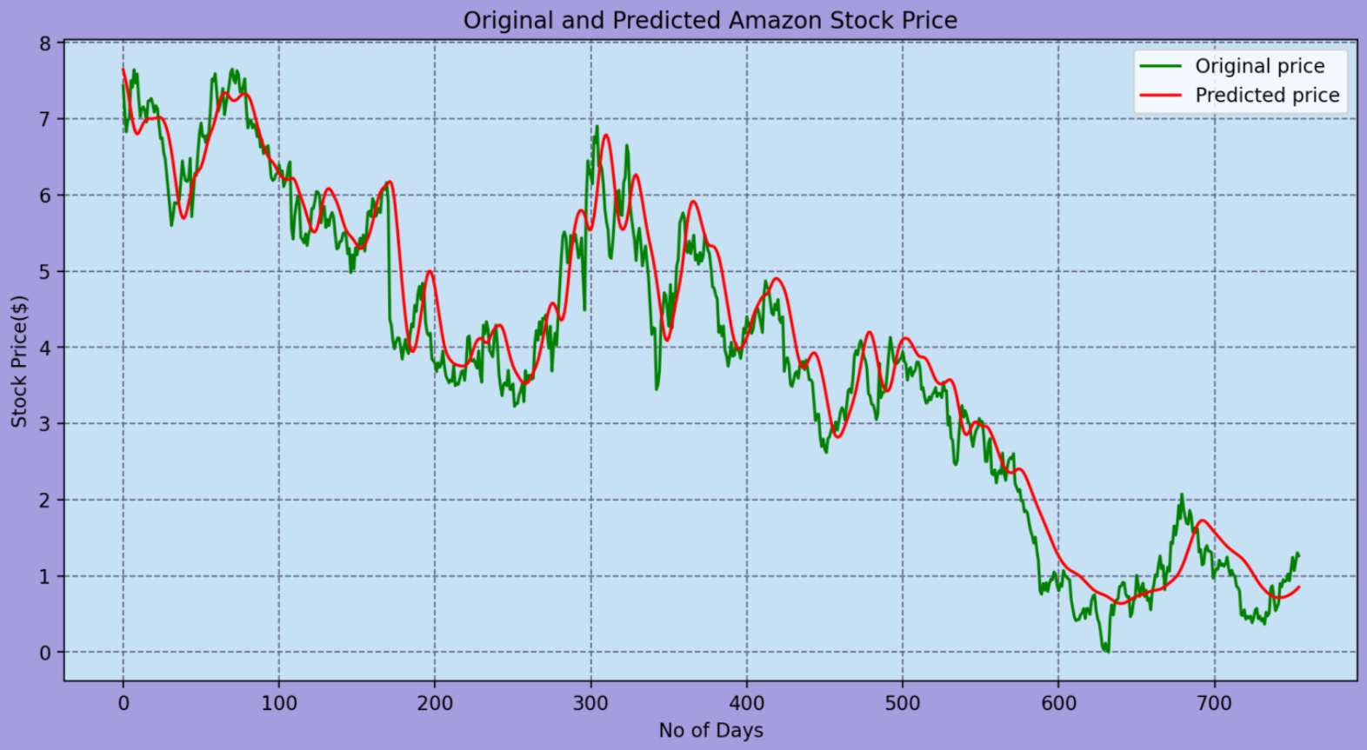
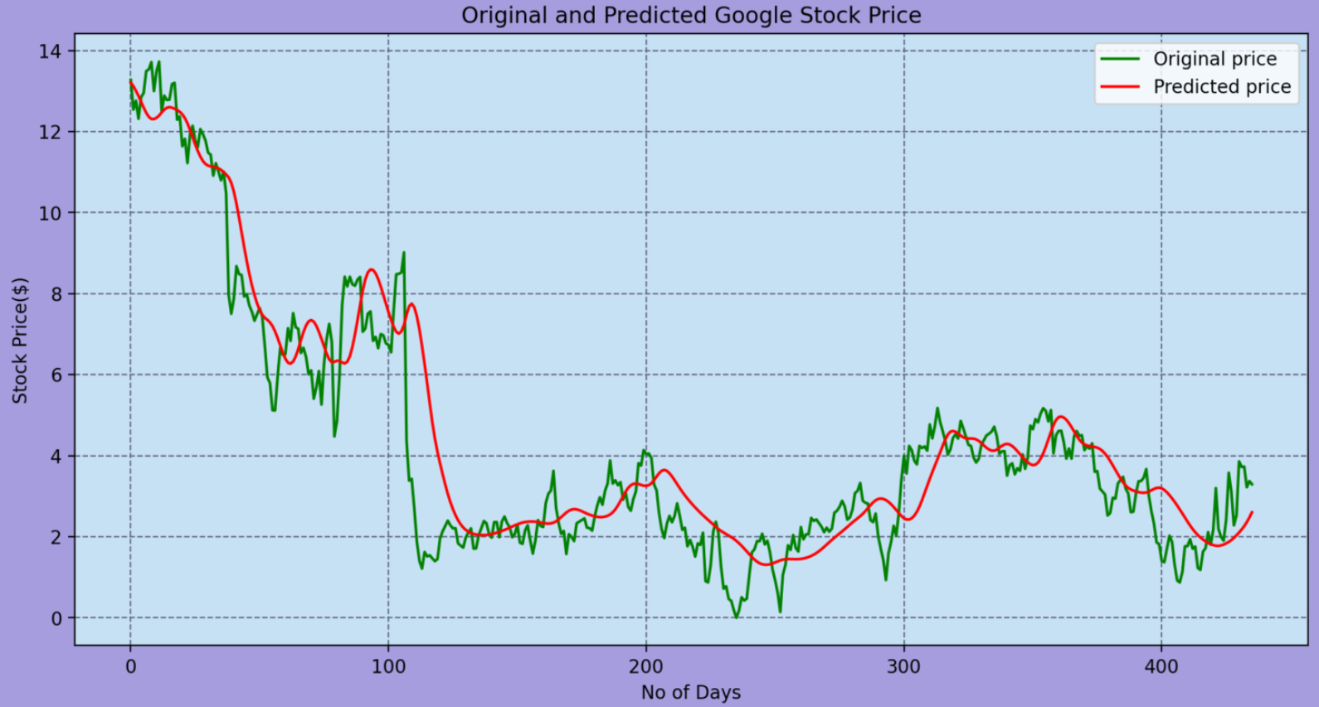
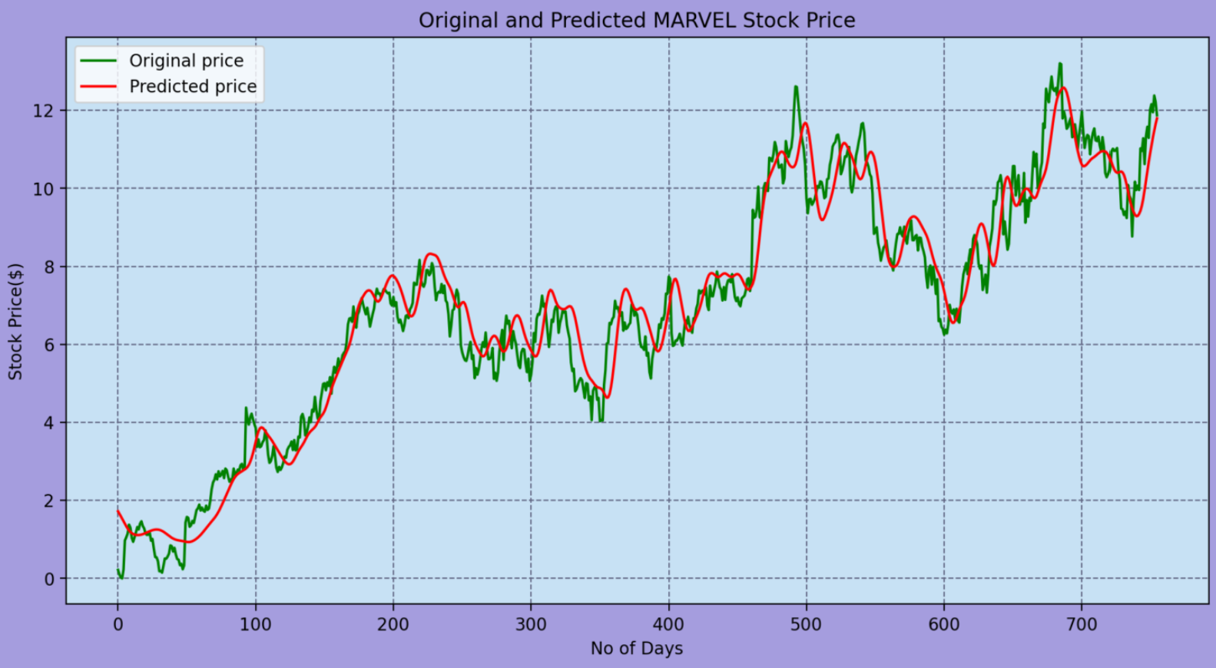
Performance & Evaluation Metrics of Different Company Stocks in Real-Time

Slide 14
Overcoming existing methodology
To overcome the existing methodology for the project "Stock Prediction System using Stacked-LSTM," you would follow a tailored approach that combines general methodology improvement principles with specific considerations for this project.
Set Improvement Objectives: Define clear objectives for improving the methodology. For example, your objectives might include increasing prediction accuracy, reducing training time, enhancing model interpretability, or incorporating additional features for better forecasting.
Experiment with Model Architectures: Experiment with different architectures and configurations of Stacked-LSTM models. Explore variations such as different numbers of LSTM layers, varying hidden units, dropout rates, or using attention mechanisms to focus on relevant information.
Data Preprocessing and Feature Engineering: Evaluate and improve data preprocessing techniques and feature engineering methods. Consider incorporating additional data sources or engineered features that may enhance the predictive power of the model.

Slide 15
Evaluate and Validate: Thoroughly evaluate and validate the improved methodology using appropriate metrics and validation techniques. Use techniques such as cross-validation, time-series split validation, or rolling-window validation to ensure the robustness and generalization of the model.
Backtesting and Simulation: Conduct backtesting and simulation exercises to assess the performance of the improved methodology in real-world scenarios. This helps validate the practical utility and effectiveness of the model in making investment decisions.
Documentation and Reproducibility: Document all changes and improvements made to the methodology, including code modifications, parameter settings, and experimental results. Ensure that the process is well-documented and reproducible to facilitate future iterations and collaborations.
Continuous Monitoring and Updating: Establish mechanisms for continuous monitoring of the model's performance in production environments. Monitor key performance metrics over time and be prepared to update the methodology as new data becomes available or market conditions change.

Slide 16
Modules used:
import numpy as np
import pandas as pd
import matplotlib.pyplot as plt
import pandas_datareader as data
from sklearn.preprocessing import MinMaxScaler
from keras.layers import Dense, Dropout, LSTM
from keras.models import Sequential
from keras.layers import Dense, Dropout, LSTM, BatchNormalization
from keras.callbacks import TensorBoard
from keras.callbacks import ModelCheckpoint
from tensorflow.keras.optimizers import Adam
import tensorflow as tf
from tensorflow.keras.metrics import MeanSquaredError, MeanAbsoluteError
from tensorflow_addons.metrics import RSquare
import tensorflow as tf
from tensorflow.python.framework import ops
from tensorflow.python.keras.models import Sequential
from tensorflow.python.keras.layers import Dense, Flatten, GlobalAveragePooling2D, Activation
import tensorflow.compat.v2 as tf

Slide 17
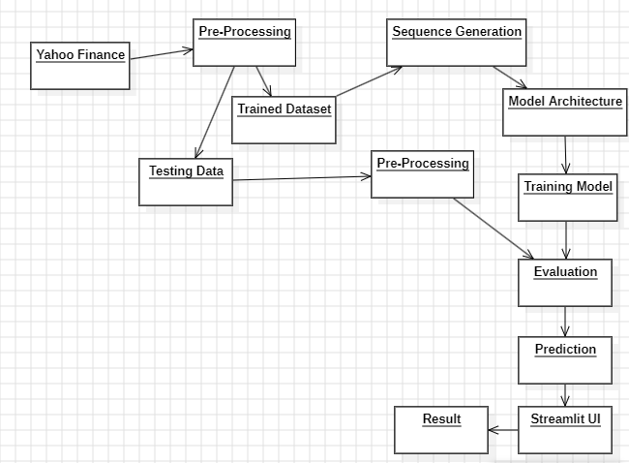
Architecture / Data Flow Diagram

Slide 18
Phase 1 – Work Flow & Algorithm Used
Workflow includes:
Preprocessing- Preprocessing of data includes changing of datatypes of features for testing and training the data. Also removal of empty values from dataset.
Splitting of Dataset: Splitting of dataset into two: Testing dataset and training dataset. Testing dataset are used to compare the data-values with predicted values from the model. Also, in our model, we have (70% of training dataset and 30% of testing dataset) used for training.
Sequence Generation: Sequence generation in LSTM refers to the process of generating new sequences of data based on patterns learned from a training dataset. This capability is particularly useful in tasks such as text generation, music composition, and time series forecasting.
Model Architecture: Model Architecture includes imports of various modules and packages which facilitate the model execution in runtime environment.
from keras.layers import Dense, Dropout, LSTM
from keras.models import Sequential
from keras.layers import Dense, Dropout, LSTM, BatchNormalization
from keras.callbacks import TensorBoard
from keras.callbacks import ModelCheckpoint
from tensorflow.keras.optimizers import Adam
import tensorflow as tf

Slide 19
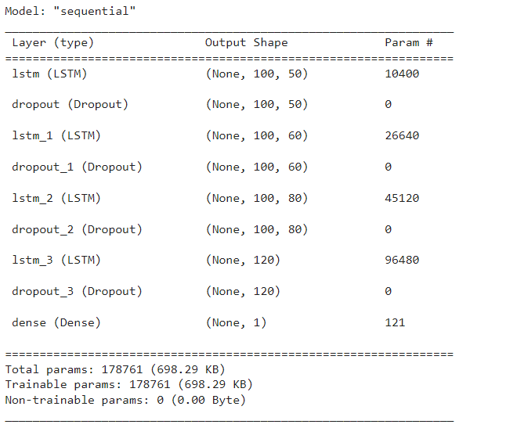
Phase 1 – Work Flow & Algorithm Used
5. Training Model: In our Stacked-LSTM model, we have included layers like LSTM with units=50,60,80 and 120 . At last , we combined all the layers using while
model.add(tf.keras.layers.Dense(units=1, kernel_initializer=Orthogonal(gain=1.0, seed=None)))
While initializing the optimizers as
# Set Optimizer
opt = Adam(learning_rate=0.001, beta_1=0.9, beta_2=0.999, epsilon=1e-07)
6. Evaluation: For evaluation,we assumed that taking mean of previous 100 days and 200 days to date would be considered for comparison of model predicted value.

Slide 20
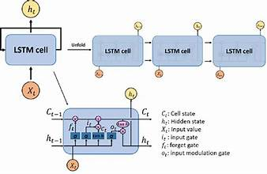
Phase 1 – Work Flow & Algorithm Used
Input Layer:
The input layer of an LSTM network receives sequential data, such as time series data or text data.Each input in the sequence is represented as a vector of features. For example, in stock price prediction, each input may contain historical price data or technical indicators.
LSTM Layers
LSTM Layer (Memory Cell):
The core of the LSTM architecture is the LSTM layer, also known as the memory cell.The LSTM layer consists of multiple memory cells, each responsible for capturing and storing information over time.
Forget Gate:
The forget gate determines which information from the previous time step should be discarded or forgotten.
It takes as input the concatenation of the current input and the output from the previous time step and outputs a forget vector.
Output Layer:
The output layer receives the output from the LSTM layer and produces the final predictions or classifications.
Depending on the task, the output layer may consist of one or more neurons with appropriate activation functions.

Slide 21
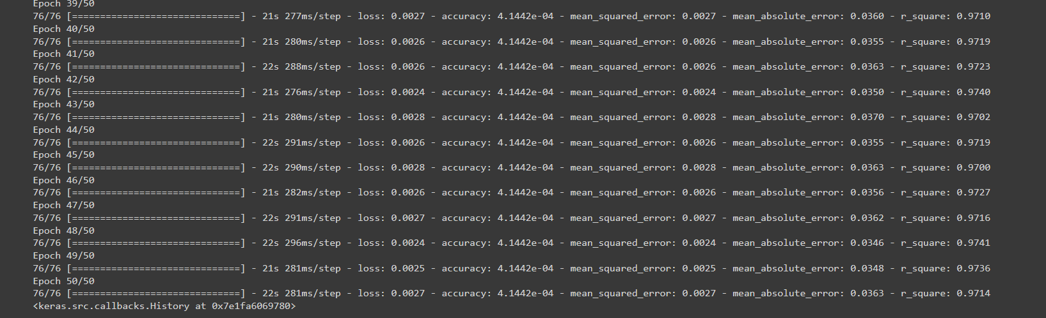
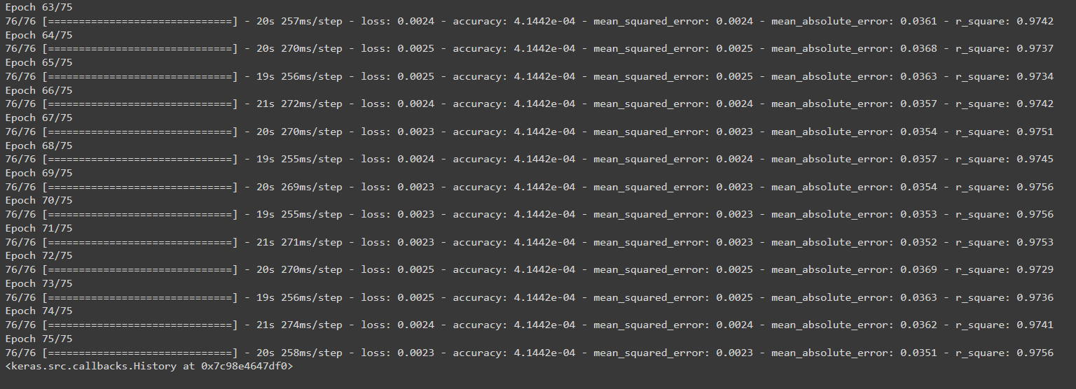
Phase 2 – Evaluation metrics & Performance Analysis
Epoch=50
Mean_Squared_Error= 0.0027
Mean_Absolute Error= 0.0363
R_Square=0.9714
Epoch=75
Mean_Squared_Error= 0.0023
Mean_Absolute Error= 0.0351
R_Square=0.9756

Slide 22
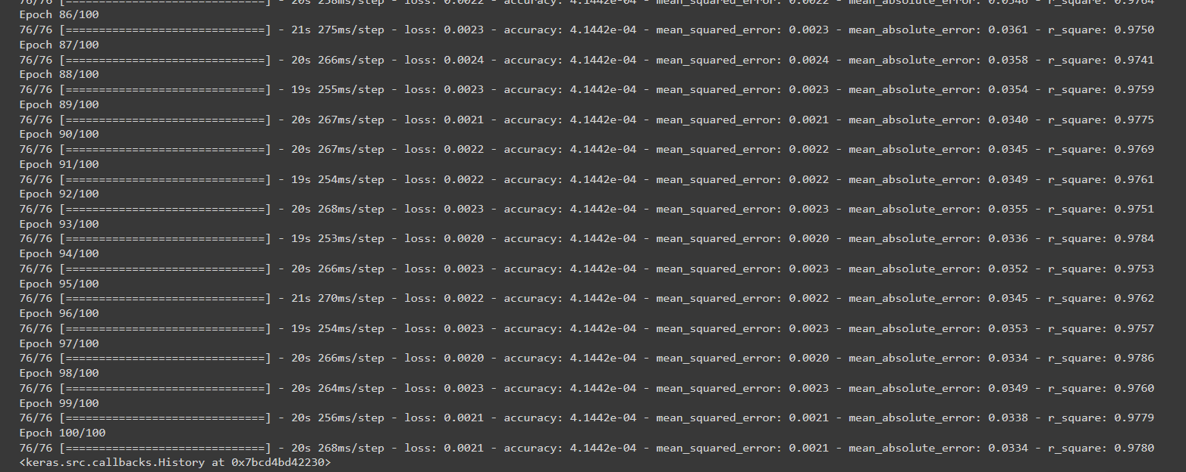
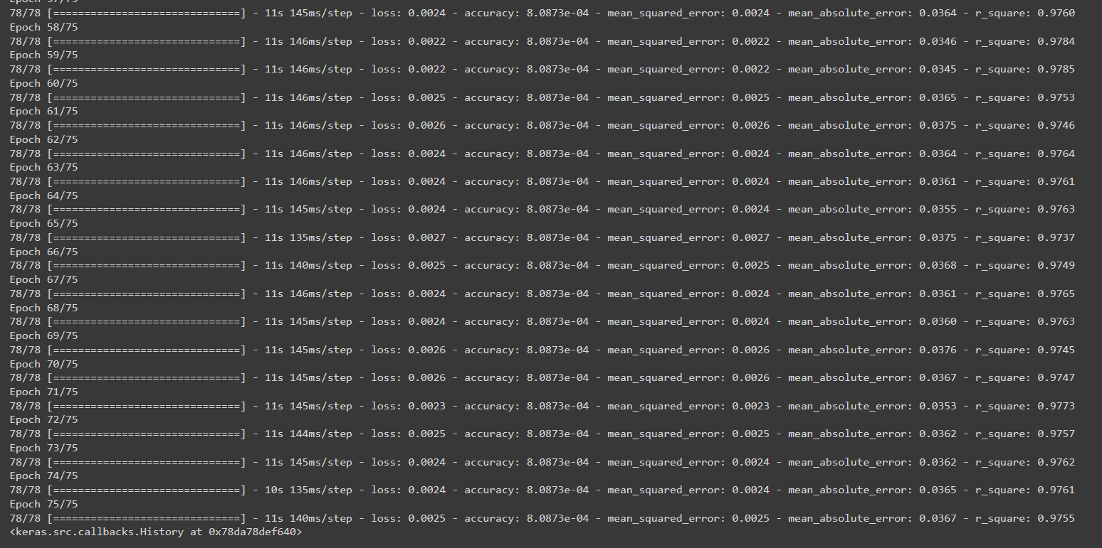
Phase 2 – Evaluation metrics & Performance Analysis
Epoch=100
Mean_Squared_Error= 0.0021
Mean_Absolute Error= 0.0334
R_Square=0.9780
Epoch=75
Mean_Squared_Error= 0.0025
Mean_Absolute Error= 0.0367
R_Square=0.9775
Batch Size=32
Layers=6 (including Dense Layer)

Slide 23
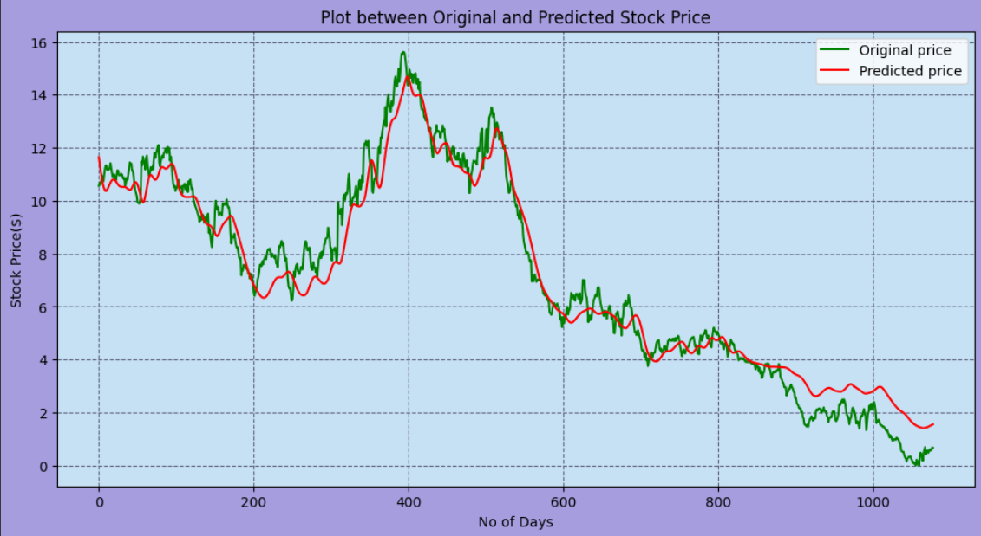
Phase 3 – Results & Discussion
The following plot is created for the prediction of Google Stock with the model trained at epochs=50 , with batch size= 32. The model was initialized with 5 layers with dropout value of (0.5) in last layer of LSTM.
The achieved result is:
Mean_Squared_Error= 0.0027
Mean_Absolute Error= 0.0363
R_Square=0.9714
Epochs-50 result

Slide 24

Phase 3 – Results & Discussion
The following plot is created for the prediction of Google Stock with the model trained at epochs=75 , with batch size=32. The model was initialized with 5 layers with dropout value of (0.5) in last layer.
The achieved result is:
Mean_Squared_Error= 0.0023
Mean_Absolute Error= 0.0351
R_Square=0.9756
Epochs-75 result

Slide 25
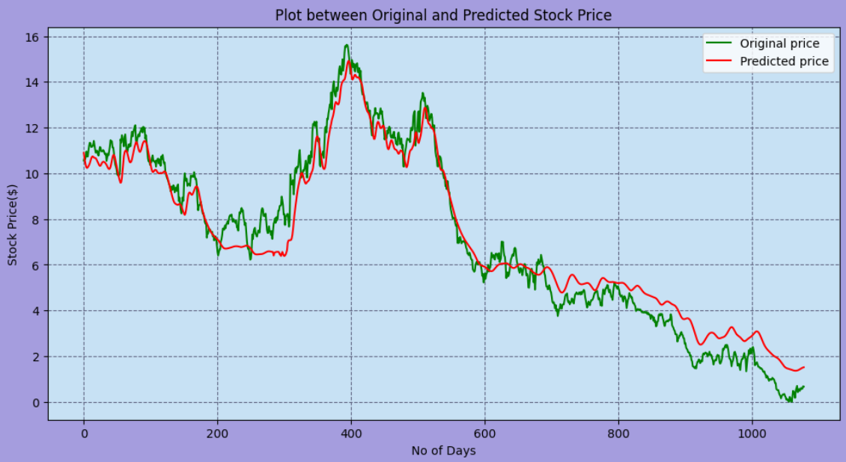
Phase 3 – Results & Discussion
The following plot is created for the prediction of Google Stock with the model trained at epochs=100 , with batch size= 32. The model was initialized with 5 layers with dropout value of (0.5) in last layer.
The achieved result is:
Mean_Squared_Error= 0.0021
Mean_Absolute Error= 0.0334
R_Square=0.9780
Epochs-100 result

Slide 26
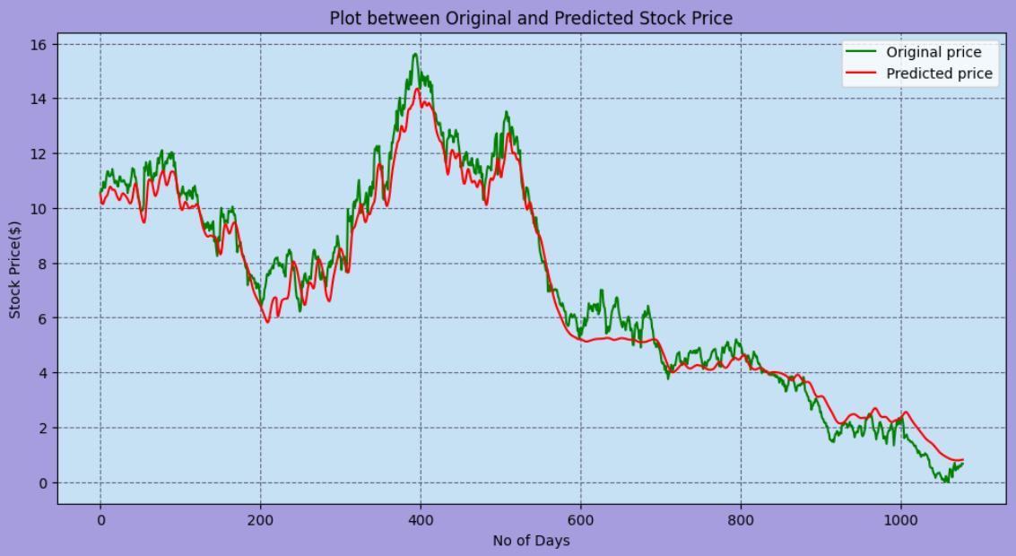
Phase 3 – Results & Discussion
The following plot is created for the prediction of Google Stock with the model trained at epochs=75 , with batch size= 32. The model was initialized with 6 layers with dropout value of (0.5) in last layer.
The achieved result is:
Mean_Squared_Error = 0.0025
Mean_Absolute Error= 0.0367
R_Square=0.9775
Epochs-75 result

Slide 27
Phase 4 – Conclusion & Future Enhancement
Model-1
Model trained for 50 epochs, 5 layers, dropout 0.5 in the last layer:
Mean Squared Error (MSE): 0.0027
Mean Absolute Error (MAE): 0.0363
R-Square (R²): 0.9714
Model-2
Model trained for 75 epochs, 6 layers, dropout 0.5 in the last layer:
Mean Squared Error (MSE): 0.0025
Mean Absolute Error (MAE): 0.0367
R-Square (R²): 0.9775
Model-3
Model trained for 75 epochs, 5 layers, dropout 0.5 in the last layer:
Mean Squared Error (MSE): 0.0023
Mean Absolute Error (MAE): 0.0351
R-Square (R²): 0.9756
Model-4
Model trained for 100 epochs, 5 layers, dropout 0.5 in the last layer:
Mean Squared Error (MSE): 0.0021
Mean Absolute Error (MAE): 0.0334
R-Square (R²): 0.9780

Slide 28
Phase 4 – Conclusion & Future Enhancement
To determine which model is better for predicting Google Stock prices and better trained, let's compare the metrics of each model configuration:
Evaluation:
The performance of these models can be assessed based on the MSE, MAE, and R² values:
Lower MSE suggests a model that makes predictions closer to the actual data points.
Lower MAE indicates a model that, on average, errors less in its predictions.
Higher R² indicates a model that better explains the variance in the data from the predictors.
Best Performing Model:
The model trained for 100 epochs with 5 layers (dropout of 0.5 in the last layer) demonstrates the best performance across all the metrics compared:
MSE: It has the lowest MSE of 0.0021, suggesting the least errors squared over the dataset.
MAE: It also has the lowest MAE of 0.0334, meaning it averages the smallest errors.
R²: The highest R² of 0.9780, indicating it explains the most variance among the models compared.
Conclusion:
The model trained for 100 epochs, with 5 layers and dropout of 0.5 in the last layer is the best model for prediction and is the better-trained model among those listed. This configuration provides the most accurate and reliable predictions for Google Stock prices based on the metrics provided. The results suggest that a well-balanced approach to epochs and layers, without excessive complexity (as might be the case with 6 layers), yields the most effective training outcome.

Slide 29
References
[1] B. Wang, F. L. Zhang, “Comparison of synthetic neural community and time series version for forecasting stock prices”, Journal of Wuhan University of Technology (Information and Management Engineering), vol. 27, no. 6, pp. Sixty-nine-73, 2005.
[2] J. Lin, Y. H. Guo, “Short time period prediction of inventory expenses primarily based on neural networks”, Journal of Southwest Jiao-tong University, vol. 33, no. 3, pp. 299-304, 1998.
[3] J. H. Sun, “Long time series clustering method and its utility in inventory rate”, Diss. WuHan University, 2011.
[4] Dose, Christian, and Silvano Cincotti. "Clustering of financial time series with application to index and enhanced index tracking portfolio." Physical A: Statistical Mechanics and its Applications 355.1 (2005): 145-151.
[5] M. Arora, S. Verma, Kavita, and S. Chopra, “A systematic literature review of machine learning estimation approaches in scrum projects,” Cognitive Informatics and Soft Computing, vol. 1040, pp. 573–586, 2020.
[6] G. Yang, M. A. Jan, A. U. Rehman, M. Babar, M. M. Aimal and S. Verma, "Interoperability and Data Storage in Internet of Multimedia Things: Investigating Current Trends,Research Challenges and Future Directions," in IEEE
Access, vol. 8, pp. 124382-124401, 2020, doi:10.1109/ACCESS.2020.3006036.
[7] S. Ramisetty, S. Varma, and S. Varma, “The amalgamative sharp wireless sensor networks routing and with enhanced machine learning,” Journal of Computational and Theoretical Nanoscience, vol. 16, no. 9, pp. 3766–3769, 2019.

Slide 30
References
[8] S. Kumar, R. Shanker and S. Verma, "Context Aware Dynamic Permission Model: A Retrospect of Privacy and Security in Android System," 2018 International Conference on Intelligent Circuits and Systems (ICICS), Phagwara,India, 2018, pp. 324-329, doi: 10.1109/ICICS.2018.00073.
[9] Kaur, M.; Verma, S.; Kavita. Flying Ad-Hoc Network(FANET): Challenges and Routing Protocols. J. Comput.
Theor. Nanosci. 2020, 17, 2575–2581
[10] G. Alex, “Supervised collection labelling with recurrent neural networks”, Studies in Computational Intelligence, vol. 385, 2012.
[11] Cabitza, F., Locoro, A., & Ban-fi, G. (2018). Machine gaining knowledge of in orthopedics: a literature review. Frontiers in Bioengineering and Biotechnology, 6, 75.
[12] Almulhim, M., Islam, N., & Zaman, N. (2019). A lightweight and secure authentication scheme for IoT based e-health applications. International Journal of Computer Science and Network Security, 19(1), 107-120.
[13] Chiu, D. Y., & Chen, P. J. (2009). Dynamically exploring internal mechanism of stock marketplace by using fuzzy-primarily based support vector machines with excessive dimensional input space and genetic set of rules. Expert Systems with Applications, 36(2), 1240-1248.
[14] Hamid, B., Jhanjhi, N. Z., Humayun, M., Khan, A., & Alsayat, A. (2019, December). Cyber security issues and challenges for smart cities: A survey. In 2019 13th International Conference on Mathematics, Actuarial
Science, Computer Science and Statistics (MACS) (pp. 1-7).IEEE.

Slide 31
References
[15] Dai, W., Wu, J. Y., & Lu, C. J. (2012). Combining nonlinear impartial thing analy-sis and neural community for the prediction of Asian stock market indexes. Expert structures with packages, 39(4), 4444-4452.
[16] Zaman, N., Low, T. J.,& Alghamdi, T. (2014, February). Energy efficient routing protocol for wireless sensor network. In 16th international conference on advanced communication technology (pp. 808-814). IEEE.
[17] Dash, R., & Dash, P. K. (2016). A hybrid stock buying and selling body-paintings integrating technical analysis with system getting to know techniques. The Journal of Finance And Data Science, 2(1), forty-two-57.
[18] Shah, I. A., Sial, Q., Jhanjhi, N. Z., & Gaur, L. (2023). Use Cases for Digital Twin. In Digital Twins and Healthcare:Trends, Techniques, and Challenges (pp. 102-118). IGI Global.
[19] Humayun, M., Jhanjhi, N. Z., Alruwaili, M., Amalathas, S.S., Balasubramanian, V., & Selvaraj, B. (2020). Privacy protection and energy optimization for 5G-aided industrial Internet of Things. IEEE Access, 8, 183665-183677.
[20] Guresen, E., Kayakutlu, G., & Daim, T. U. (2011). Using artificial neural community models in inventory market index prediction. Expert Systems with Applications,38(eight), 10389-10397.
[21] Jhanjhi, N. Z., Brohi, S. N., & Malik, N. A. (2019, December). Proposing a rank and wormhole attack detection framework using machine learning. In 2019 13th International Conference on Mathematics, Actuarial Science, Computer Science and Statistics (MACS) (pp. 1-9).IEEE.

Slide 32
References
[22] Ghosh, G. et al. "Secure Surveillance System Using Chaotic Image Encryption Technique." in IOP Conference Series: Materials Science and Engineering, 2020, 993(1), 012062.
[23] Shah, I. A., Jhanjhi, N. Z., Humayun, M., & Ghosh, U. (2022). Health Care Digital Revolution During COVID-19. In How COVID-19 is Accelerating the Digital Revolution (pp. 17-30). Springer, Cham.
[24] Ramisetty, Sowjanya et al. "The Amalgamative Sharp Wireless Sensor Networks Routing and with Enhanced Machine Learning" in Journal of Computational and Theoretical Nanoscience, Volume 16, Number 9, September 2019, pp. 3766-3769(4)
[25] Kaur, Manjit et al. “Flying Ad-Hoc Network: Challenges an Routing Protocols” in Journal of Computational and Theoretical Nanoscience, Volume 17, Number 6, June 2020, pp. 2575-2581(7)

